Slide 1


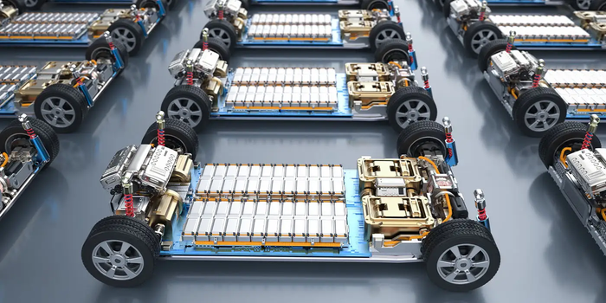
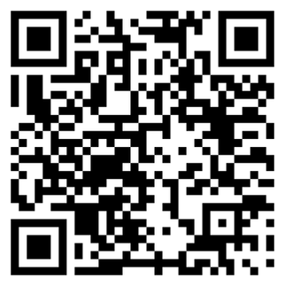
MOVE: MOBILITY AND OPERATION OF VEHICLE ELECTRIFICATION
EMPOWERING THE FUTURE OF ELECTRIC MOBILITY
EV CERTIFICATION PROGRAM FOR ENGINEERS, PLANNERS & MANAGERS
Electric Vehicles (EVs) are not just about sustainability. They are about business transformation, operational efficiency, and competitive advantage. Whether you're a fleet operator, policymaker, investor, or industry leader, the shift to EVs presents new opportunities, challenges, and strategic decisions that will shape the future of transportation.
STARTS APRIL 11, 2025
REGISTER FOR FREE
8 EXPERT-LED INTERACTIVE SESSIONS
COMPLETE THE SHORT FORM (~10 MINS)
ELECTRIC VEHICLE SYSTEMS AND FUTURE OF MOBILITY
POWERING ELECTRIC VEHICLES: INFRASTRUCTURE & ENERGY
SUSTAINABLE URBAN MOBILITY & POLICY PLANNING
ECONOMICS & STRATEGY FOR EV ADOPTION
C-TIER,UNIVERSITY OF MEMPHIS

